Slide 1


BIT07 – Machine Learning
Cedric Hermans

Slide 2
Machine Learning
Logistic regression

Slide 3
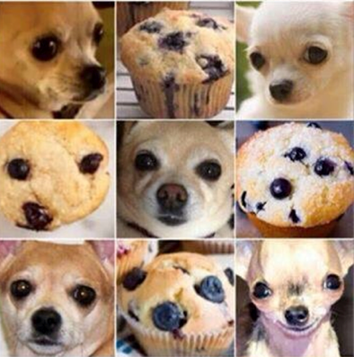
Classification
What is classification?
A predictive modeling problem where a class label is predicted for a given example of input data.
E.g., Chihuahua or muffin?

Slide 4
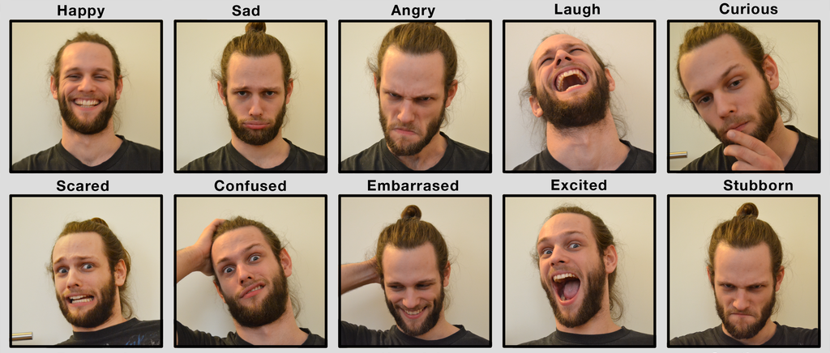
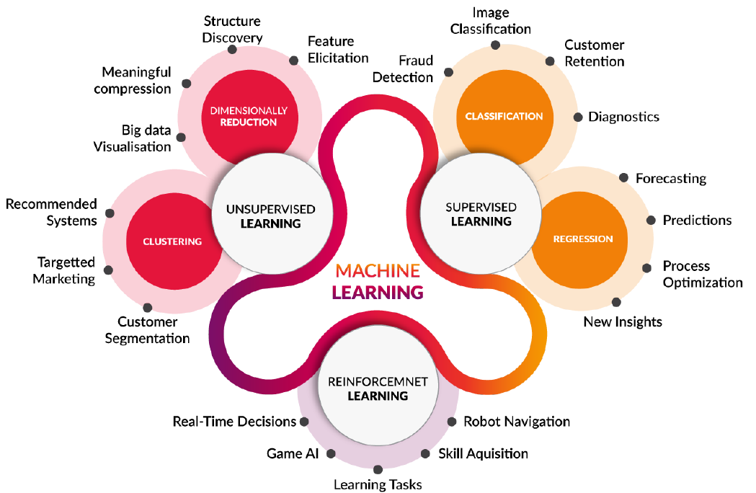
Classification
Classification applications

Slide 5
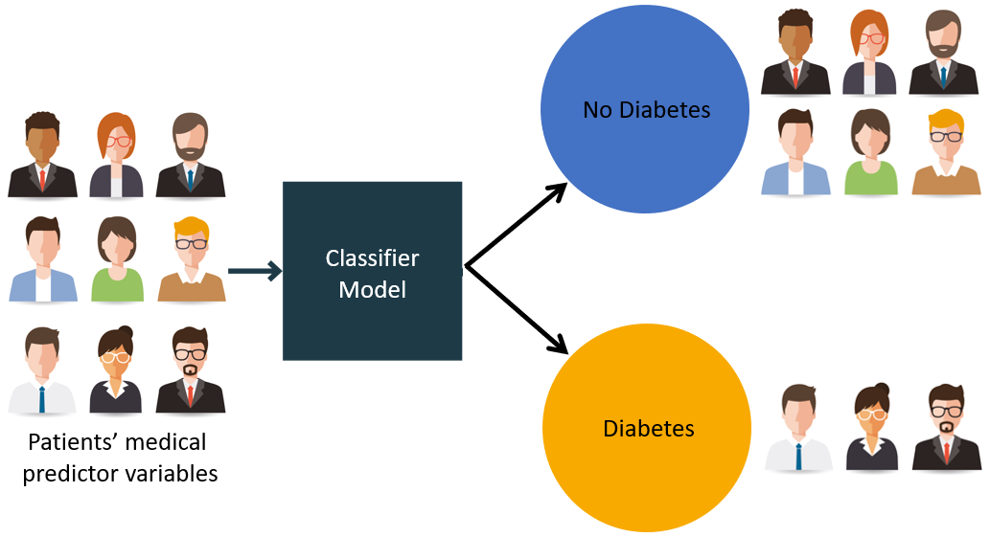
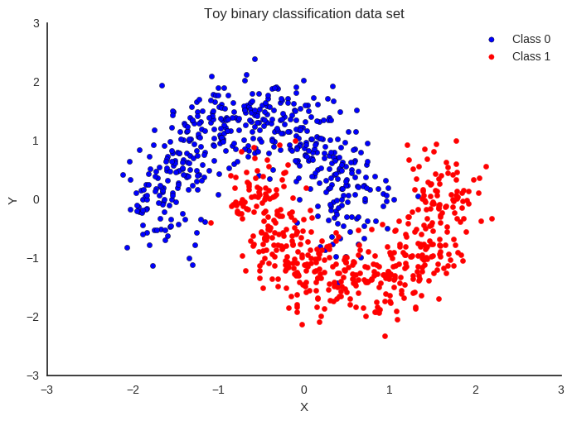
Classification
Types of classifiers
Binary (binomial) classifier
Samples are divided into two groups (classes)
E.g., benign or malign cells / gene or no gene

Slide 6
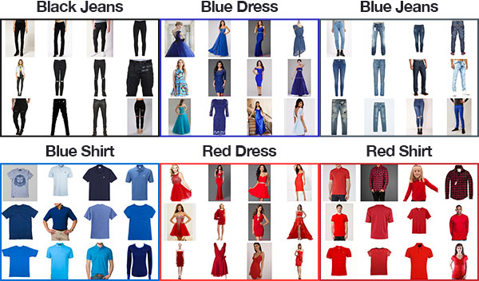
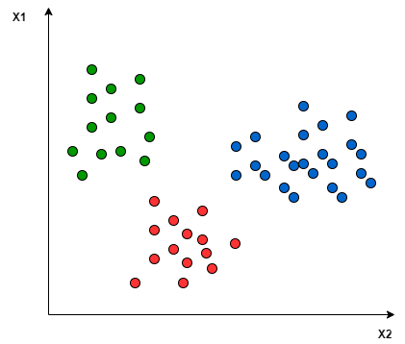
Classification
Types of classifiers
Multiclass classifier
Samples are divided into more than two groups (classes)
E.g., different clothing types

Slide 7
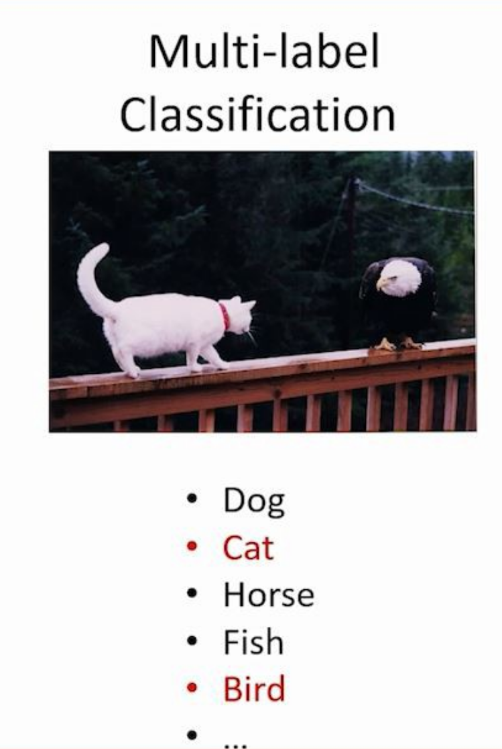
Classification
Types of classifiers
Multilabel classifier
Multiple labels per sample (a sample can belong to multiple classes)
E.g., image content analysis

Slide 8
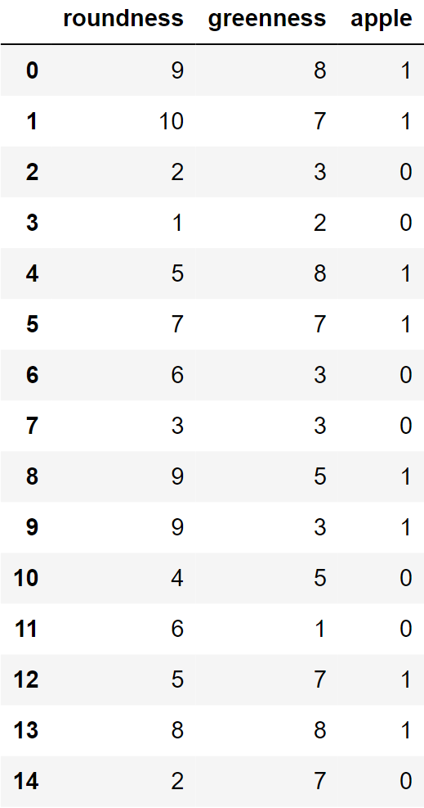
Classification
Example
Predict if a piece of fruit is an apple based on color and shape
Features: roundness and greenness
Target: apple (yes/no = 1/0)

Slide 9
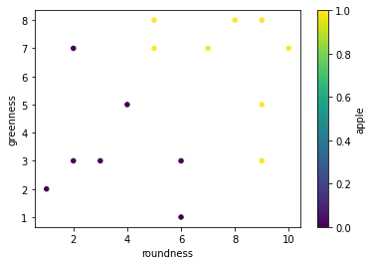
Classification
Example

Slide 10
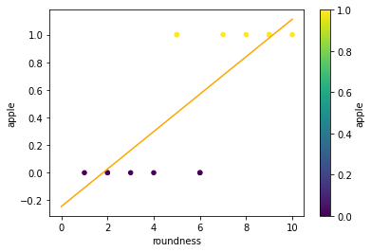
Classification
Why not regression?
Not apple
Apple
Set cutoff:
Every value <0,5 => not an apple
Every value >=0,5 => apple
All fruits with roundness <5,3 == not apple
>=5,3 == apple
Wrong
Wrong

Slide 11
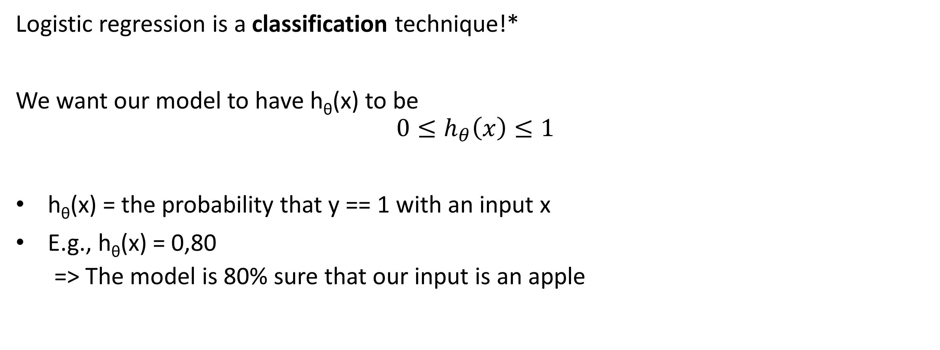
Logistic regression
Logistic regression is a classification technique!*
We want our model to have h_{θ}(x) to be
$$0≤h_{θ}\left(x\right)≤1$$
h_{θ}(x) = the probability that y == 1 with an input x
E.g., h_{θ}(x) = 0,80
=> The model is 80% sure that our input is an apple
1
0,8
0
Notes:
* In combination with a decision rule on the output of the logistic regression

Slide 12

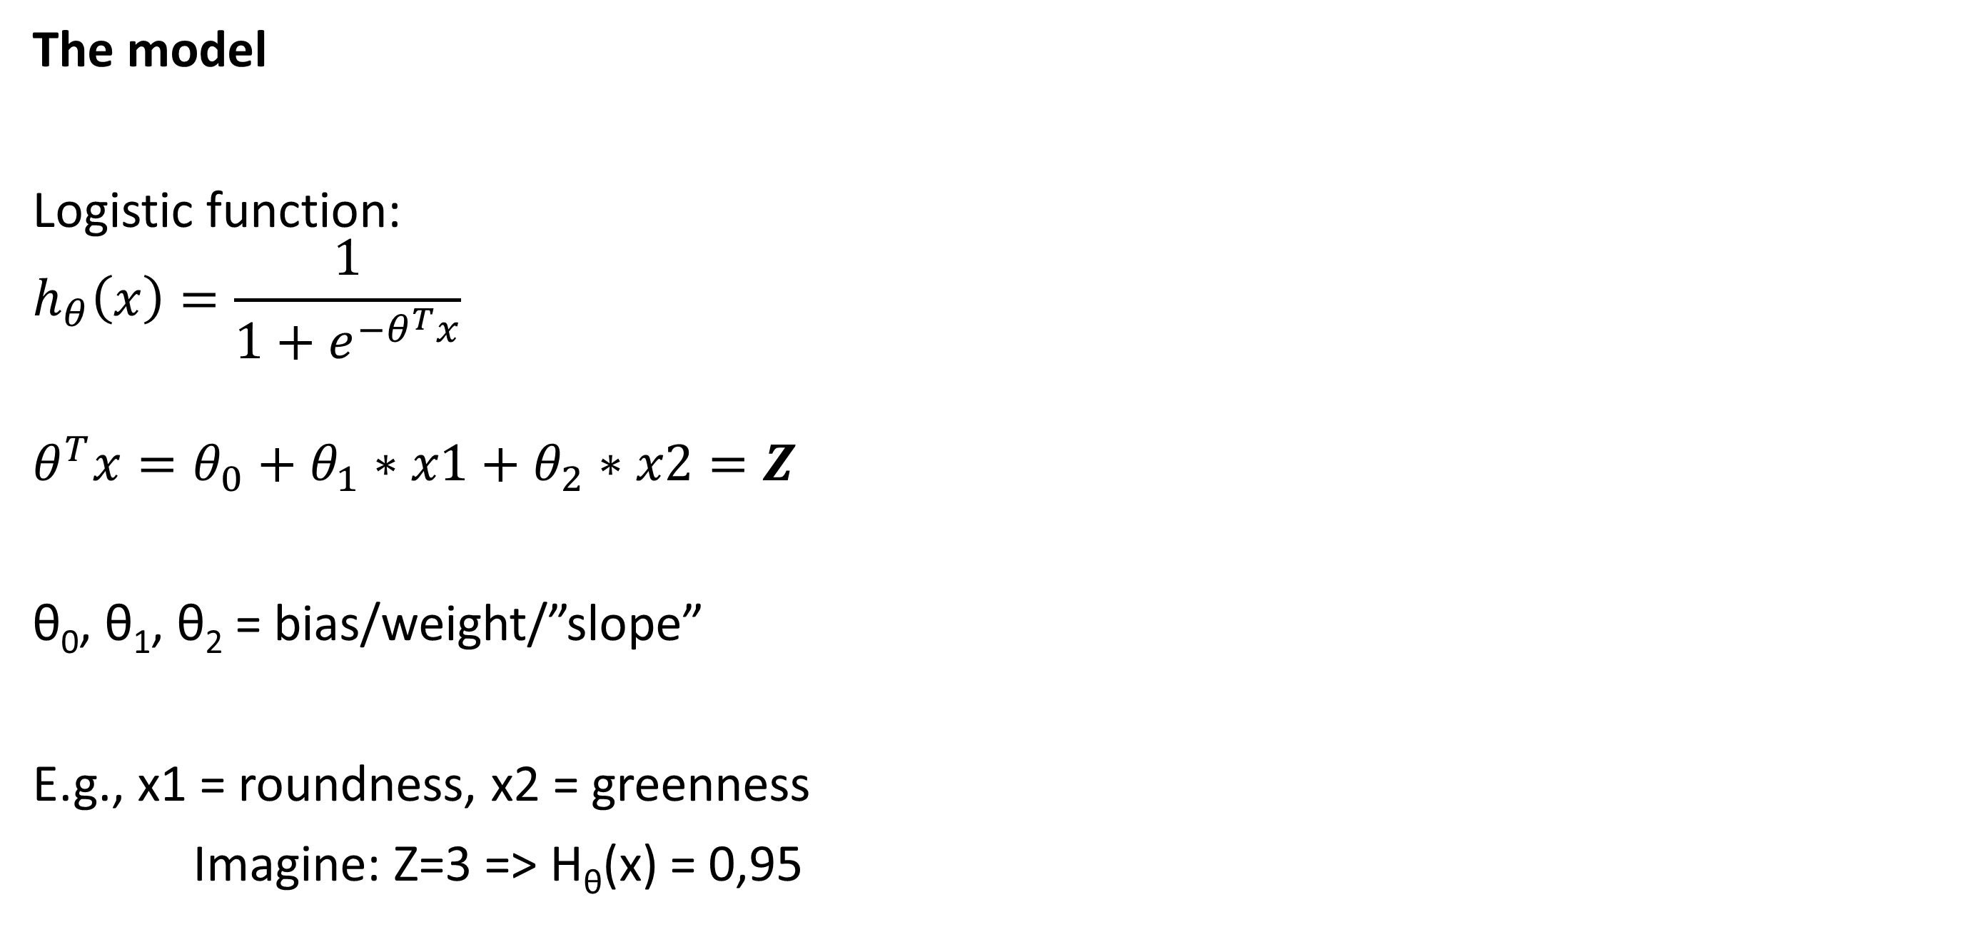
Logistic regression
The model
Logistic function:
$$h_{θ}\left(x\right)=\frac{1}{1+e^{−θ^{T}x}}$$
$$θ^{T}x=θ_{0}+θ_{1}∗x1+θ_{2}∗x2=Z$$
θ₀, θ₁, θ₂ = bias/weight/”slope”
E.g., x1 = roundness, x2 = greenness
Imagine: Z=3 => H_{θ}(x) = 0,95
H_{θ}(x)
Z

Slide 13
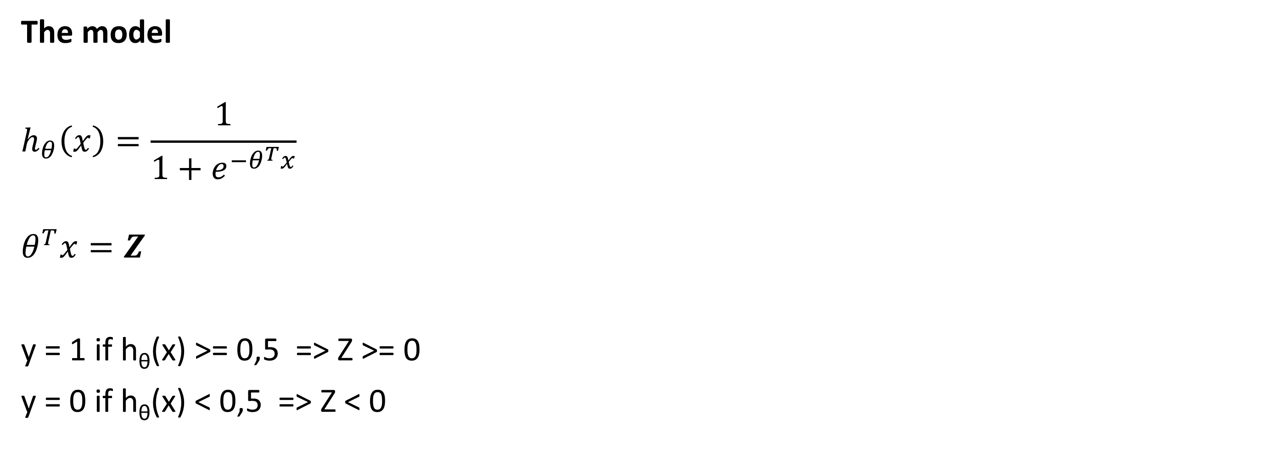
Logistic regression
The model
$$h_{θ}\left(x\right)=\frac{1}{1+e^{−θ^{T}x}}$$
$$θ^{T}x=Z$$
y = 1 if h_{θ}(x) >= 0,5 => Z >= 0
y = 0 if h_{θ}(x) < 0,5 => Z < 0
H_{θ}(x)
Z

Slide 14
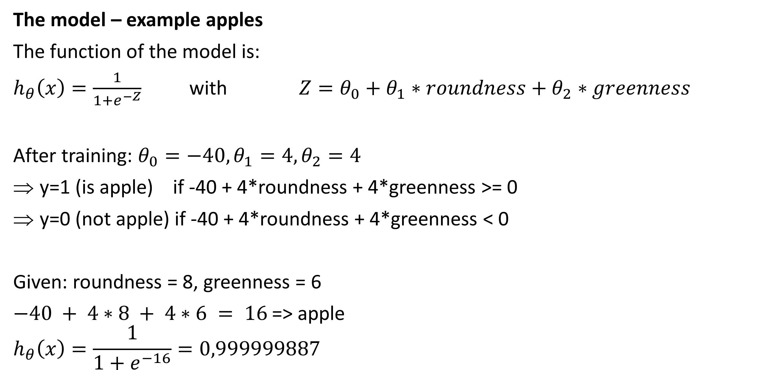
Logistic regression
The model – example apples
The function of the model is:
$h_{θ}\left(x\right)=\frac{1}{1+e^{−Z}}$ with $Z=θ_{0}+θ_{1}∗roundness+θ_{2}∗greenness$
After training: $θ_{0}=−40, θ_{1}=4, θ_{2}=4$
y=1 (is apple) if -40 + 4*roundness + 4*greenness >= 0
y=0 (not apple) if -40 + 4*roundness + 4*greenness < 0
Given: roundness = 8, greenness = 6
$−40 + 4∗8 + 4∗6 = 16$=> apple
$$h_{θ}\left(x\right)=\frac{1}{1+e^{−16}}=0,999999887$$

Slide 15
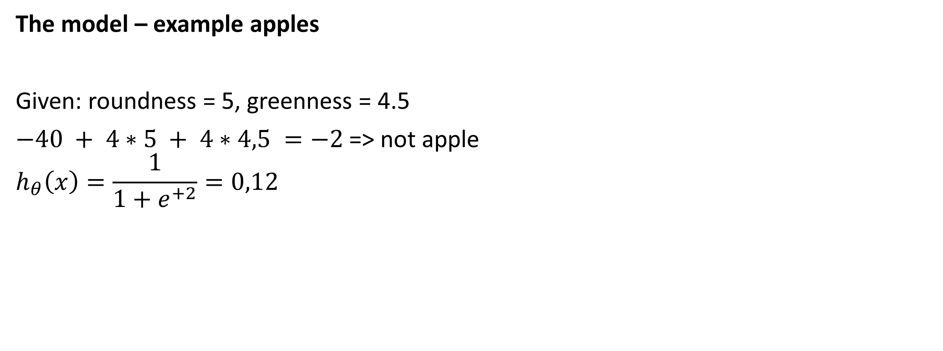
Logistic regression
The model – example apples
Given: roundness = 5, greenness = 4.5
$−40 + 4∗5 + 4∗4,5 =−2$=> not apple
$$h_{θ}\left(x\right)=\frac{1}{1+e^{+2}}=0,12$$

Slide 16
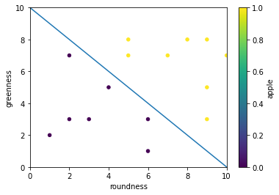
Logistic regression
The model – graphical interpretation

Slide 17
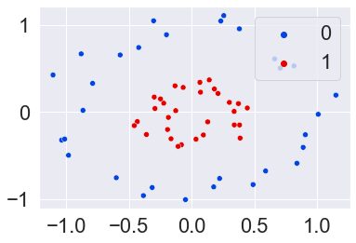
Logistic regression
Non-linear datasets

Slide 18
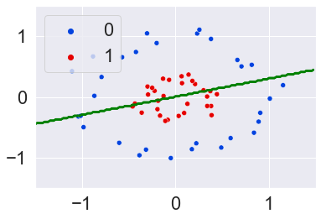
Logistic regression
Non-linear datasets

Slide 19
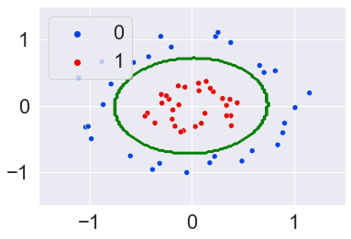
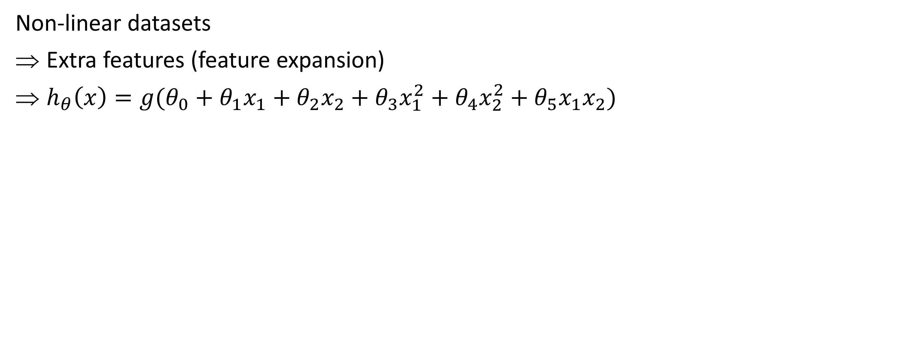
Logistic regression
Non-linear datasets
Extra features (feature expansion)
$h_{θ}\left(x\right)=g(θ_{0}+θ_{1}x_{1}+θ_{2}x_{2}+θ_{3}x_{1}^{2}+θ_{4}x_{2}^{2}+θ_{5}x_{1}x_{2})$

Slide 20
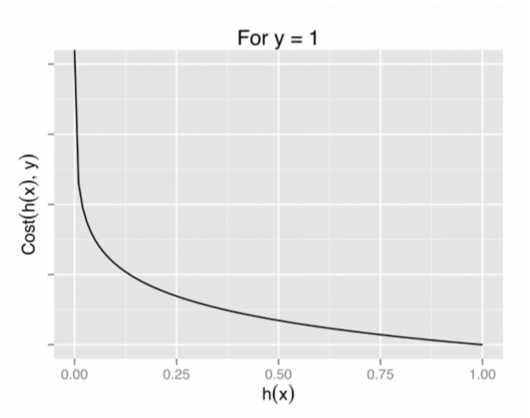
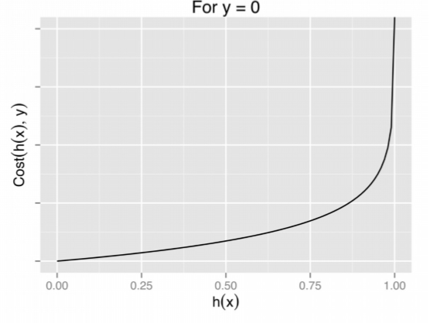
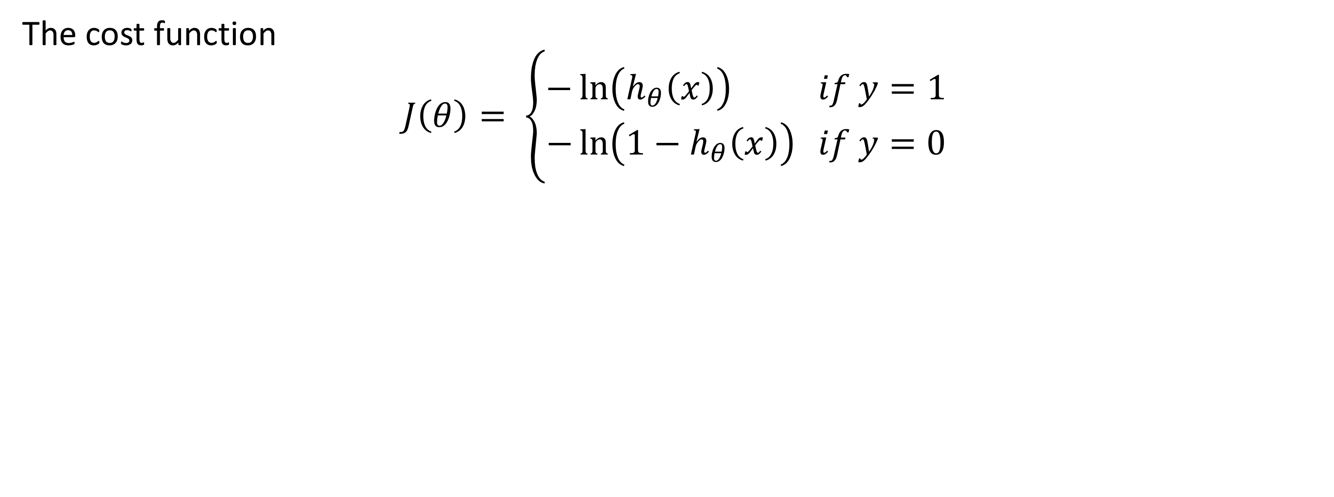
Logistic regression
The cost function
$$J\left(θ\right)= \left\{\begin{aligned}−\ln\left(h_{θ}\left(x\right)\right) if y=1 \\ −\ln\left(1−h_{θ}\left(x\right)\right) if y=0\end{aligned}\right.$$

Slide 21
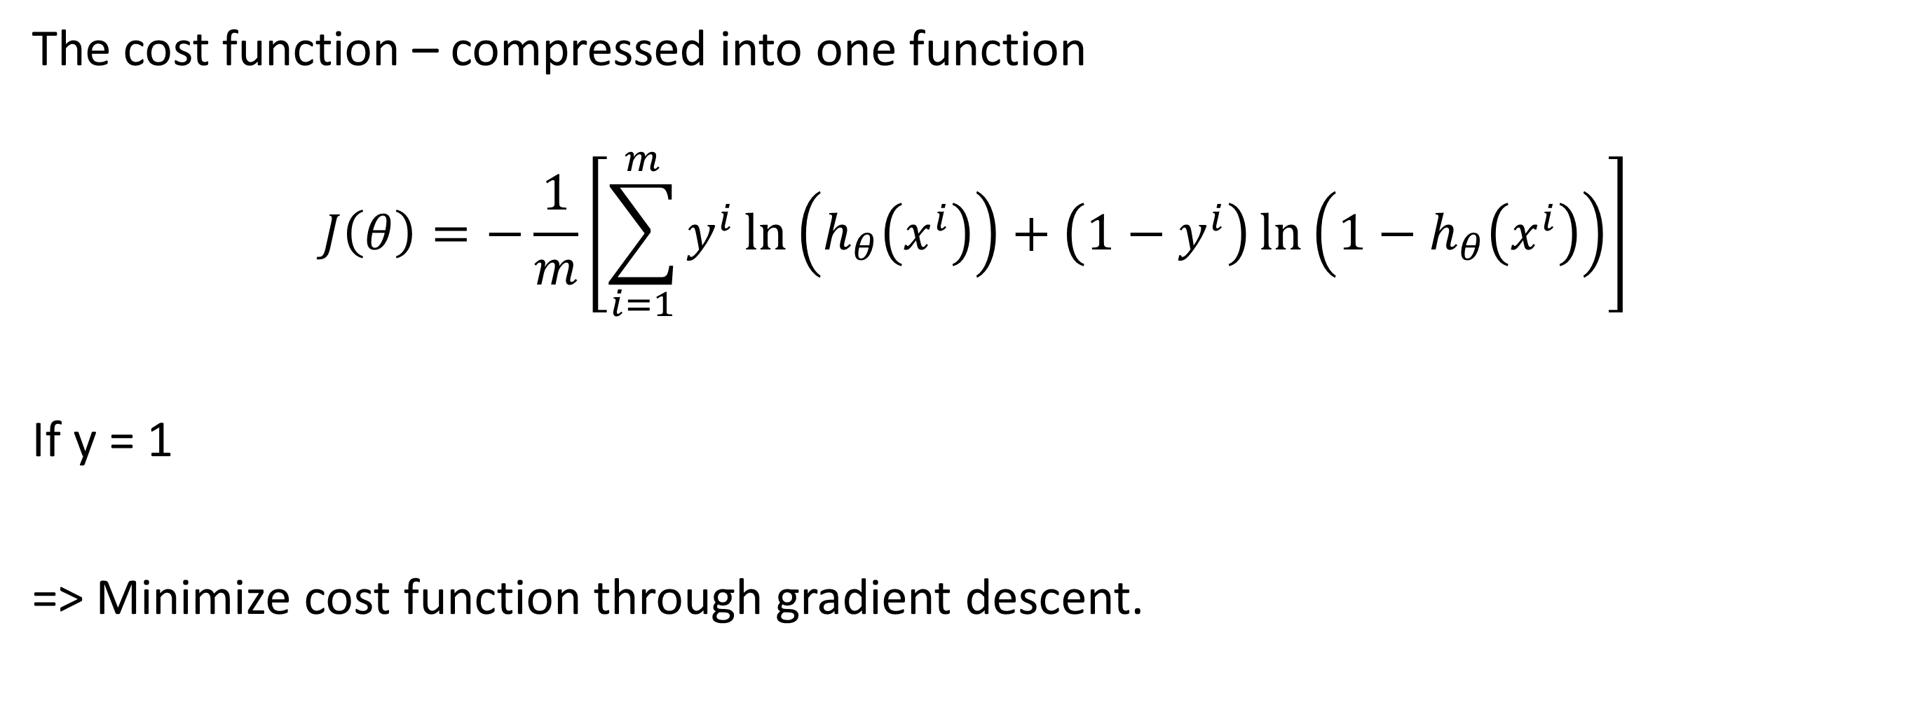
Logistic regression
The cost function – compressed into one function
$$J\left(θ\right)=−\frac{1}{m}\left[\sum_{i=1}^{m}{y^{i}\ln\left(h_{θ}\left(x^{i}\right)\right)+\left(1−y^{i}\right)\ln\left(1−h_{θ}\left(x^{i}\right)\right)}\right]$$
If y = 1
=> Minimize cost function through gradient descent.
1
1-1 = 0

Slide 22
Logistic regression – sklearn
Preprocessing
Similar to linear regression
Import the data
Check for inconsistencies
Check outliers
Plot the data
Split in features and targets
Divide into train and test set

Slide 23
Logistic regression – sklearn
Import the data
# Import the data
data=pd.read_csv("data/apples.csv")
# Split into features and targets
features=data.drop('apple',axis=1)
targets=data['apple']
# Plot the data
fig, ax = plt.subplots()
data.plot(x='roundness’,
y='greenness’,
c='apple’, # Column to base the color on
kind="scatter", # Type of plot
cmap='viridis’, # Color map
ax=ax) # Axis to plot to

Slide 24
Logistic regression – sklearn
Train a logistic regression classifier
# Initialise the model
logreg_model=linear_model.LogisticRegression(penalty="l2", C=1e5) # penalty here is not required since default is l2
# Fit the data to the model
logreg_model.fit(features,targets)
# Take a look at the score
score = logreg_model.score(features,targets)
print(f"Score: {score}") # This is the accuracy of the model
# Print coefficients and intercept
print("Coefficients: ", coefs:=logreg_model.coef_[0])
print("Intercept: ", intercept:=logreg_model.intercept_)
Score: 1.0
Coefficients: [6.11753315 5.87035436]
Intercept: [-63.07838011]
The model: $h_{θ}= \frac{1}{1+e^{−(6,12∗roundness+5,87∗greenness−63,08)}}$

Slide 25
Logistic regression – sklearn
Classifying a new sample
# Classify a new sample
# Roundness = 8 and greenness = 6:
print("Roundness = 8 and greenness = 6:")
sample=np.array([8,6]).reshape(1,-1)
# Reshape will turn [8,6] into [[8,6]] which is what the model expects
print("Apple:", logreg_model.predict(sample))
probabilities = logreg_model.predict_proba(sample)
print("Probability [chance for not apple, chance for apple]", probabilities)
# Roundness = 4 and greenness = 4:
print("Roundness = 4 and greenness = 4:")
sample=np.array([4,4]).reshape(1,-1)
print("Apple:", logreg_model.predict(sample))
probabilities = logreg_model.predict_proba(sample)
print("Probability [chance for not apple, chance for apple]", probabilities)
Roundness = 8 and greenness = 6:
Apple: [1]
Probability [chance for not apple, chance for apple] [[6.97156555e-10 9.99999999e-01]]
Roundness = 4 and greenness = 4:
Apple: [0]
Probability [chance for not apple, chance for apple] [[9.99999731e-01 2.69464181e-07]]

Slide 26
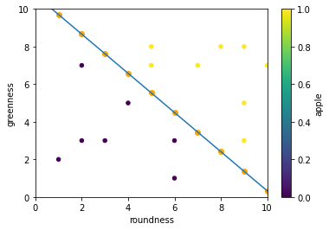
Logistic regression – sklearn
Visualize the decision boundary

Slide 27
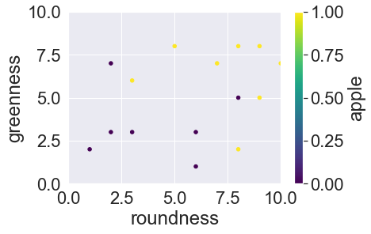
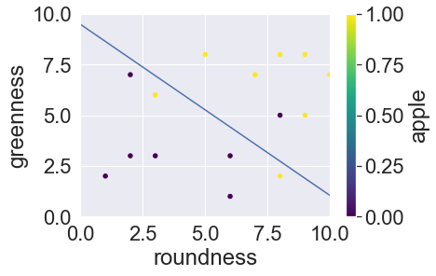
Logistic regression – sklearn
Non-linear datasets

Slide 28
Logistic regression – sklearn
Non-linear datasets -> higher order features
from sklearn.preprocessing import PolynomialFeatures
X = features.values
y= targets.values
# For example third degree features:
degree=3
# Initialize the polynomial features function
poly=PolynomialFeatures(degree)
# Fit and transform the data (could be split into two lines=> fit, transform)
features_poly = poly.fit_transform(X)
# This will add all possible combinations up to three degrees: Roundness=R and greenness = G:
# R, G, R², G², RG, R³, R²G, RG², G³
# First column is a column of ones (1) representing the 0th power.
# You can disable it with the parameter include_bias=False
# In general we don't change this.
print(features_poly)
logreg_poly = linear_model.LogisticRegression(C=1,max_iter=1000)
logreg_poly.fit(features_poly, y)

Slide 29
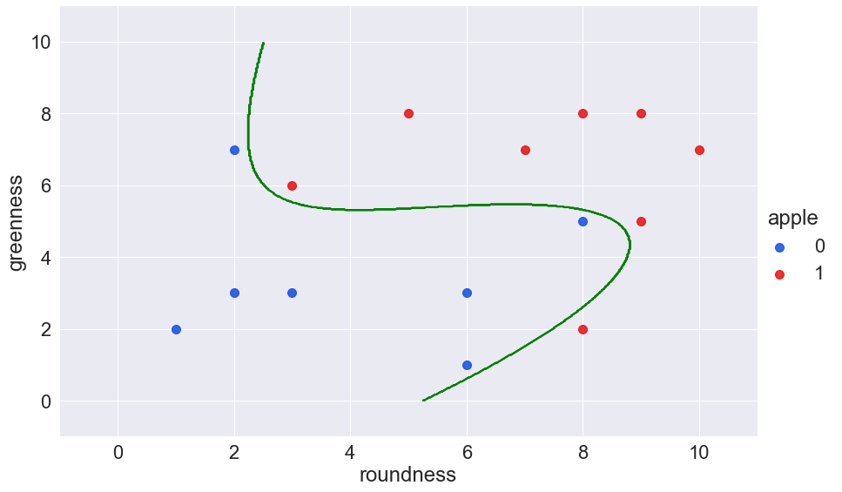
Logistic regression – sklearn
Non-linear datasets -> higher order features

Slide 30

Logistic regression – sklearn
Overfitting – underfitting

Slide 31
Logistic regression – sklearn
Overfitting – underfitting
Hyperparameter C
Complexity of the model
↑C: more complex model (=> overfitting)
↓C: simpler model (=> underfitting)
Find a balance in C to have a good model
Logreg_model = linear_model.LogisticRegression(C=100)
logreg_model.fit(X, y)

Slide 32
Logistic regression
Multi-class classification
Until now: 2 classes, what if more?
Two strategies
One-vs-All
One-vs-One

Slide 33
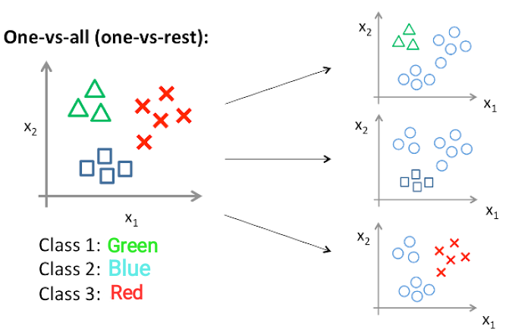
Logistic regression
Multi-class classification – One-vs-All
Creates a classifier per class
Is sample part of class: yes/no (1/0)
Total number of classifiers: for N-classes = N
More sensitive for non-balanced data
Also called one-vs-rest

Slide 34
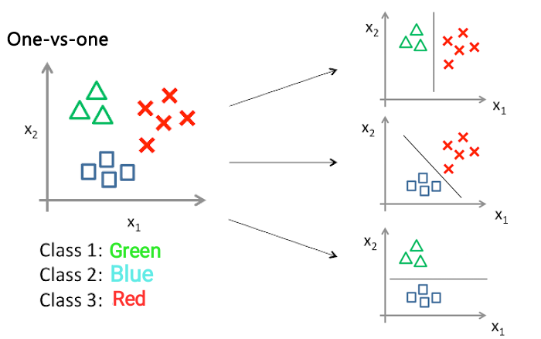
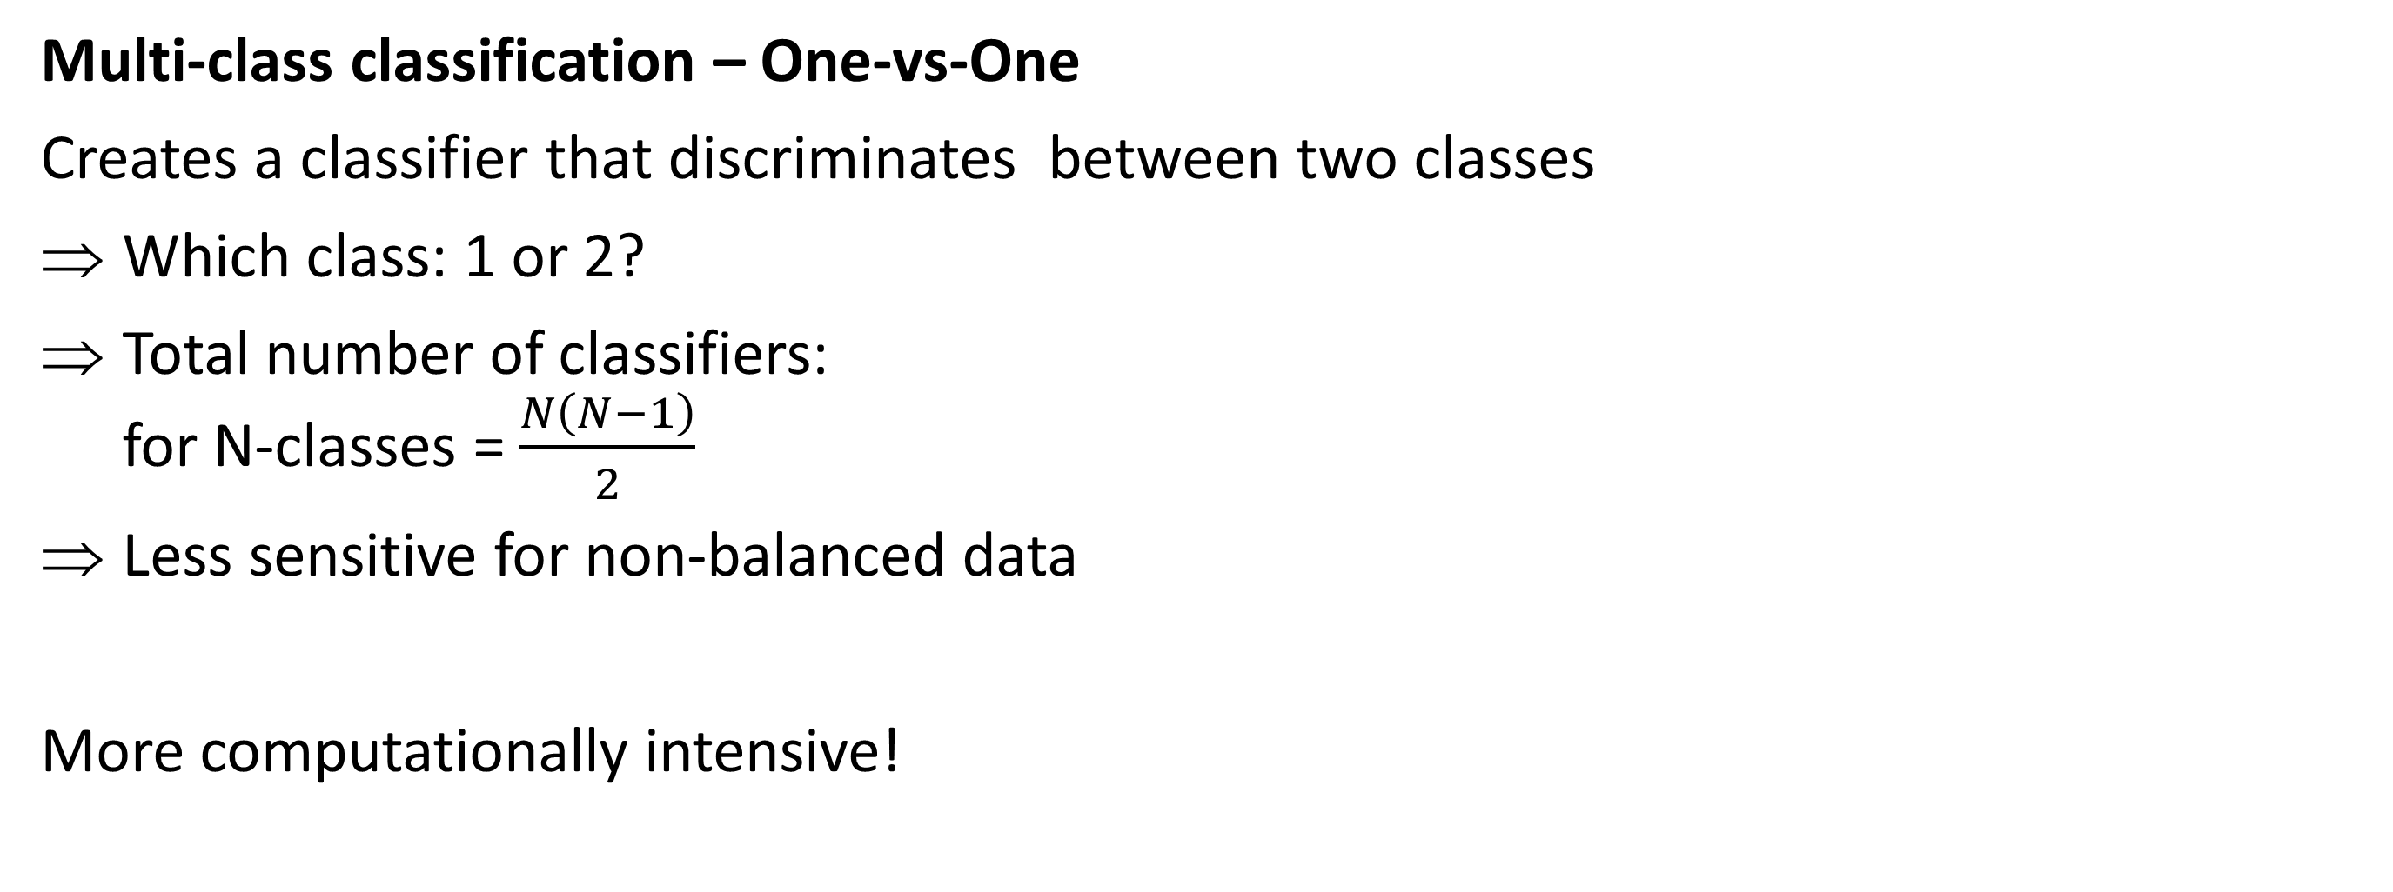
Logistic regression
Multi-class classification – One-vs-One
Creates a classifier that discriminates between two classes
Which class: 1 or 2?
Total number of classifiers: for N-classes = $\frac{N\left(N−1\right)}{2}$
Less sensitive for non-balanced data
More computationally intensive!

Slide 35
Logistic regression
Multi-class classification – sklearn
Default logistic regression for multiple classes: multinomial (not seen)
Possibility to change the strategy: multi_class: “ovr”
No one-vs-one directly possible (for logistic regression), however:
lrModel = LogisticRegression(C=0.1, multi_class="ovr")
from sklearn.multiclass import OneVsOneClassifier
# Create a logistic regression model like normal
lrModel = LogisticRegression(C=0.1)
# Wrap it in the OneVsOneClassifier function
ovo = OneVsOneClassifier(lrModel)
# Fit the data to the OneVsOneClassifier
ovo.fit(X_train,y_train)
# Predict based on the trained model
y_pred= ovo.predict(X_test)

Slide 36
Evaluation of a classifier
Different metrics are used
Always start from a “Confusion Matrix”
P: positives, n: negatives
‘: predicted
 | P’ (Predicted) | n’ (Predicted)
P (Actual) | True positives | False negatives
N (Actual) | False positives | True negatives

Slide 37
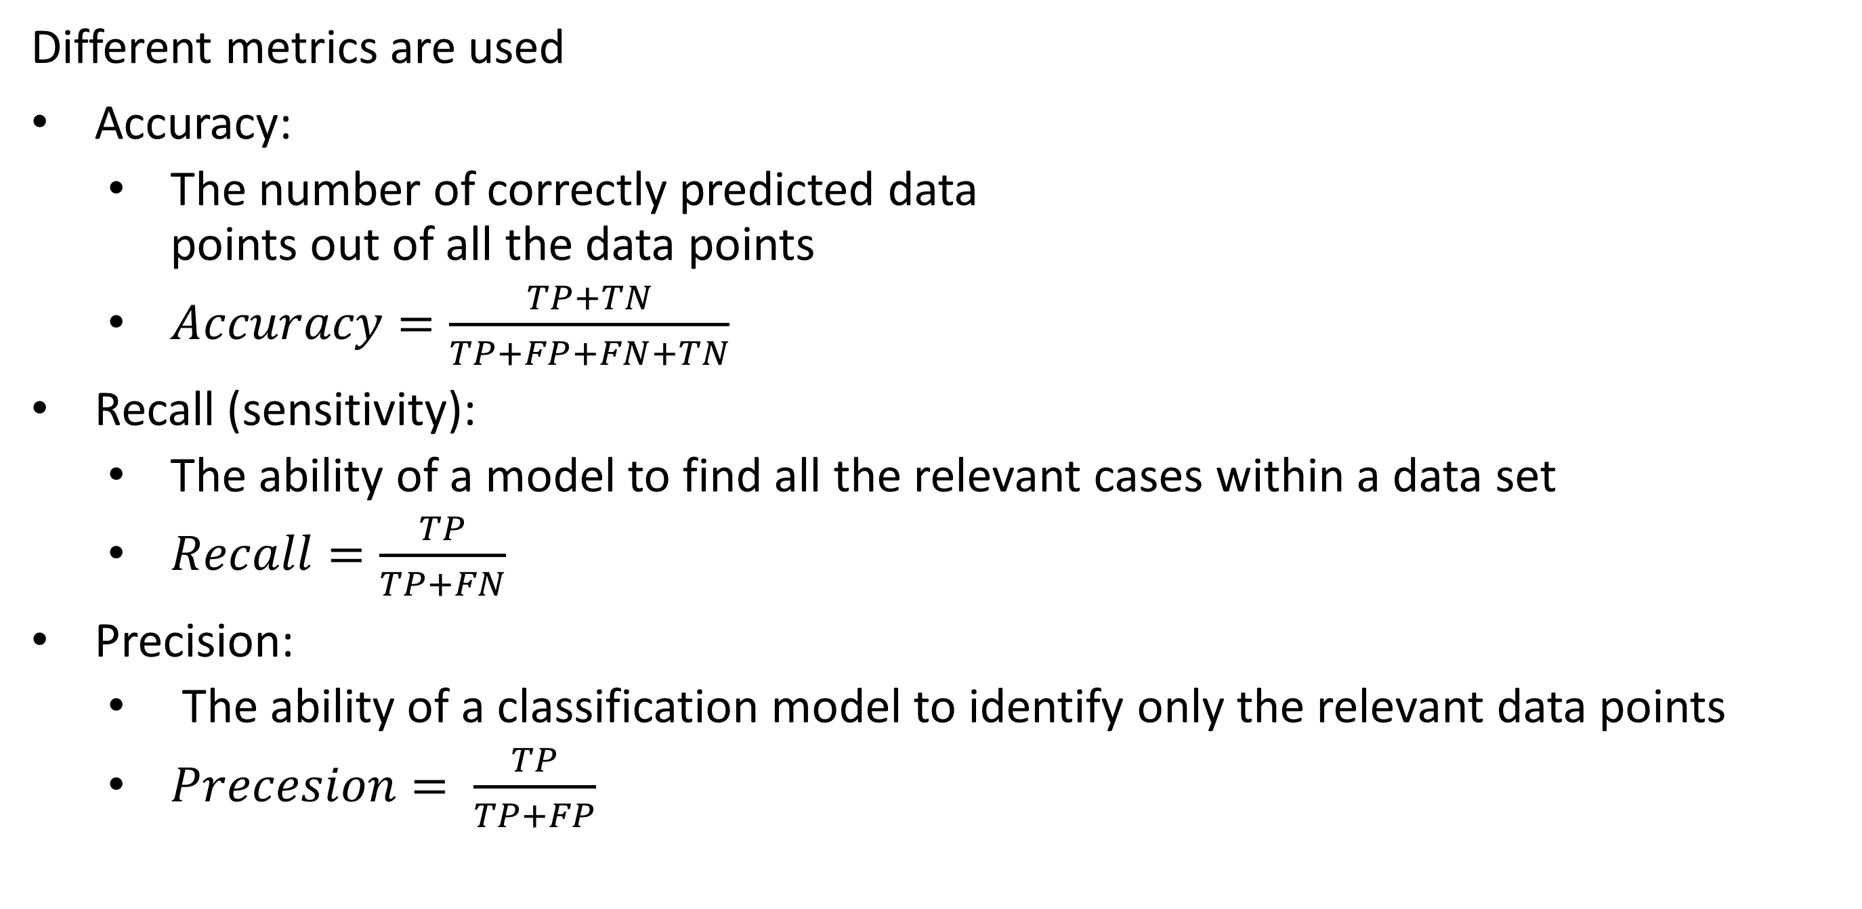
Evaluation of a classifier
Different metrics are used
Accuracy:
The number of correctly predicted data points out of all the data points
$Accuracy=\frac{TP+TN}{TP+FP+FN+TN}$
Recall (sensitivity):
The ability of a model to find all the relevant cases within a data set
$Recall=\frac{TP}{TP+FN}$
Precision:
The ability of a classification model to identify only the relevant data points
$Precesion= \frac{TP}{TP+FP}$
 | P’ (Predicted) | n’ (Predicted)
P (Actual) | TP | FN
N (Actual) | FP | TN

Slide 38
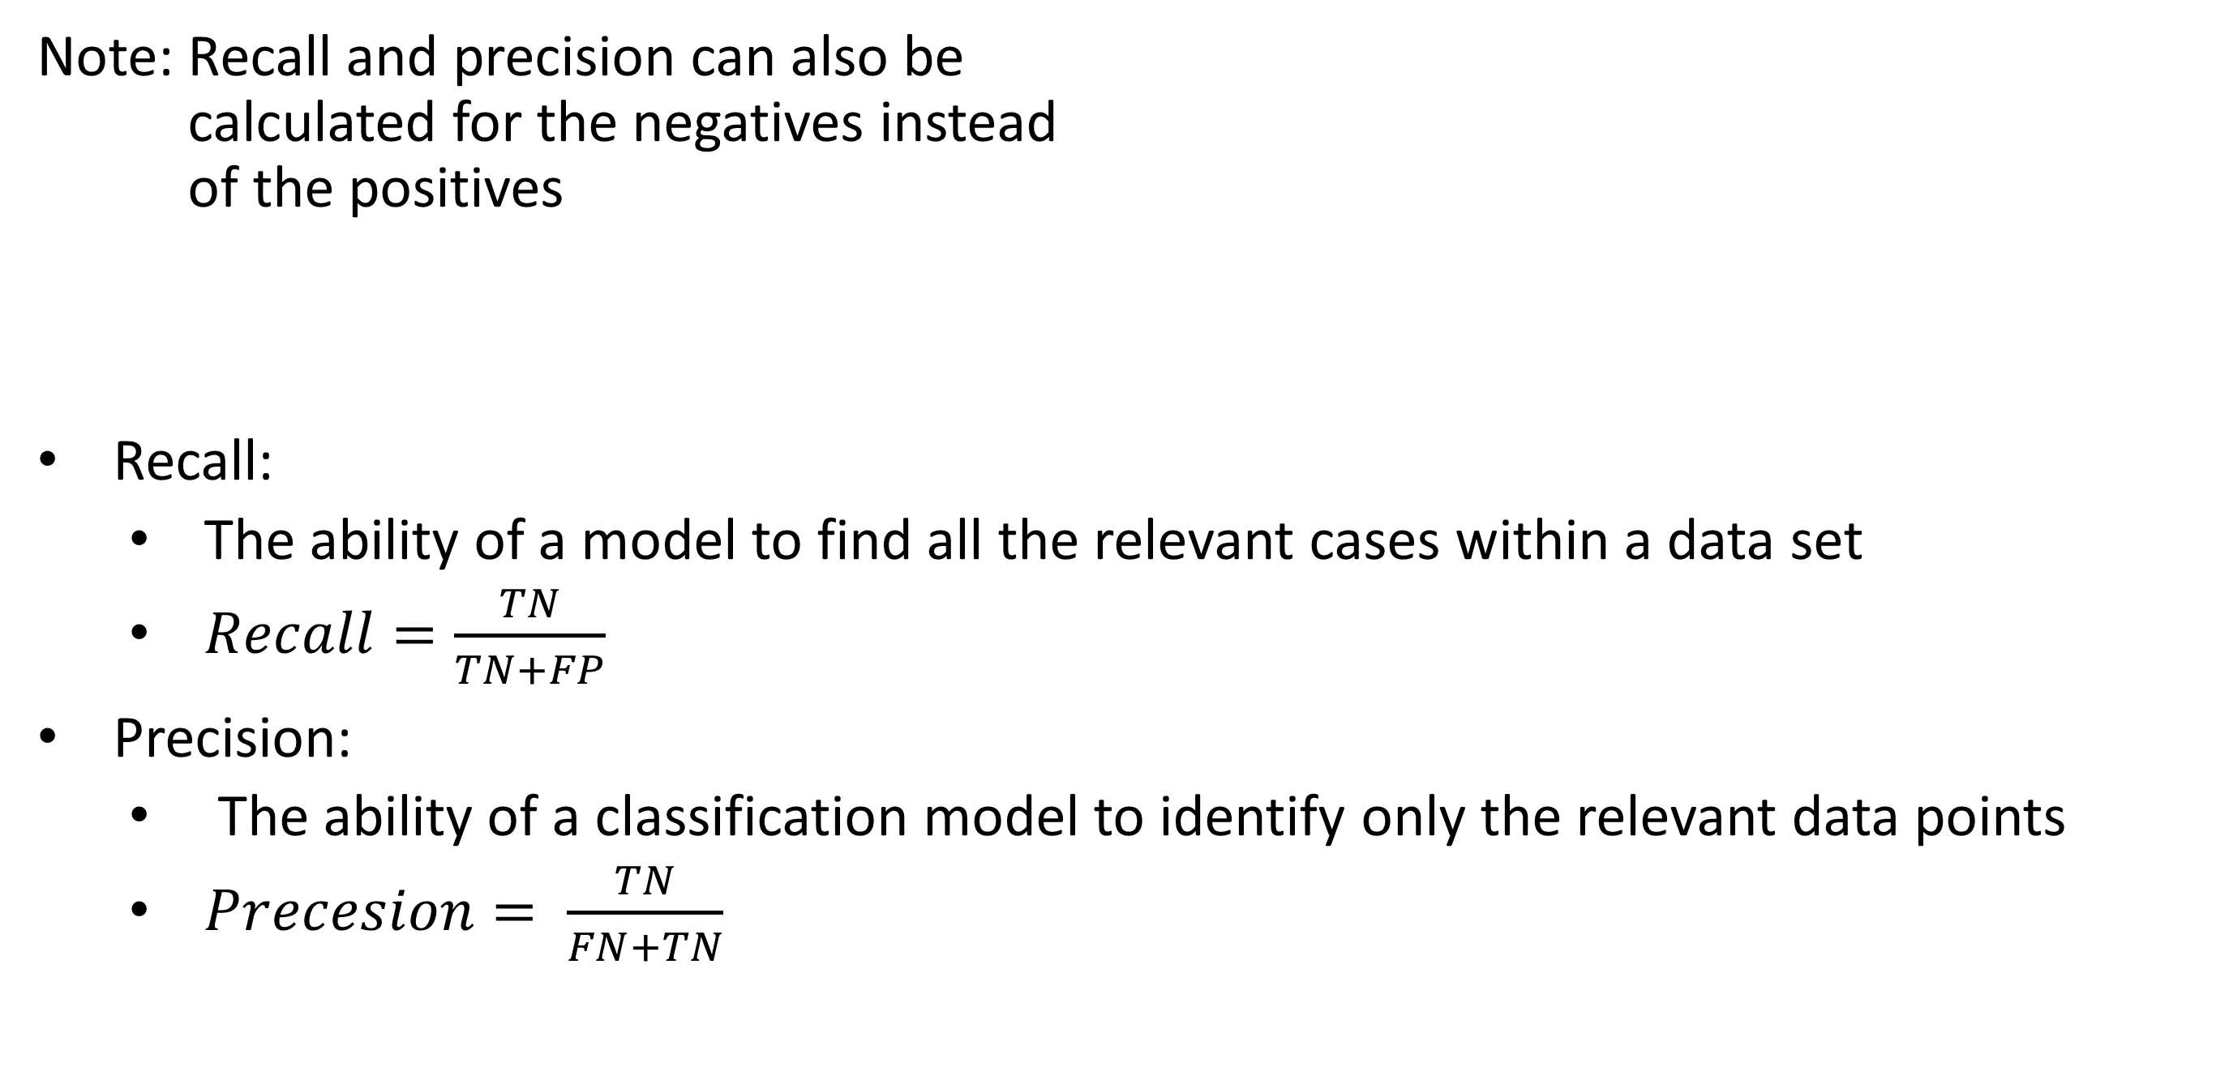
Evaluation of a classifier
Note: Recall and precision can also be calculated for the negatives instead of the positives
Recall:
The ability of a model to find all the relevant cases within a data set
$Recall=\frac{TN}{TN+FP}$
Precision:
The ability of a classification model to identify only the relevant data points
$Precesion= \frac{TN}{FN+TN}$
 | P’ (Predicted) | n’ (Predicted)
P (Actual) | TP | FN
N (Actual) | FP | TN

Slide 39
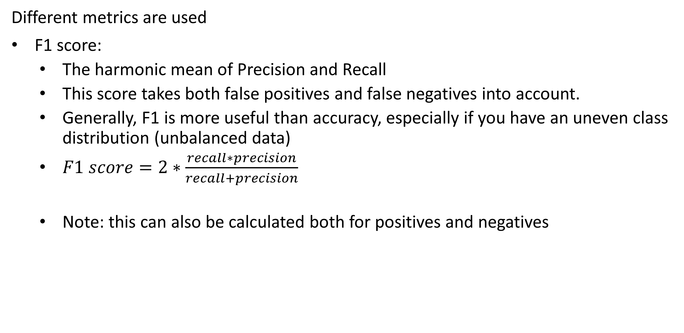
Evaluation of a classifier
Different metrics are used
F1 score:
The harmonic mean of Precision and Recall
This score takes both false positives and false negatives into account.
Generally, F1 is more useful than accuracy, especially if you have an uneven class distribution (unbalanced data)
$F1 score=2∗\frac{recall∗precision}{recall+precision}$
Note: this can also be calculated both for positives and negatives
 | P’ (Predicted) | n’ (Predicted)
P (Actual) | TP | FN
N (Actual) | FP | TN

Slide 40
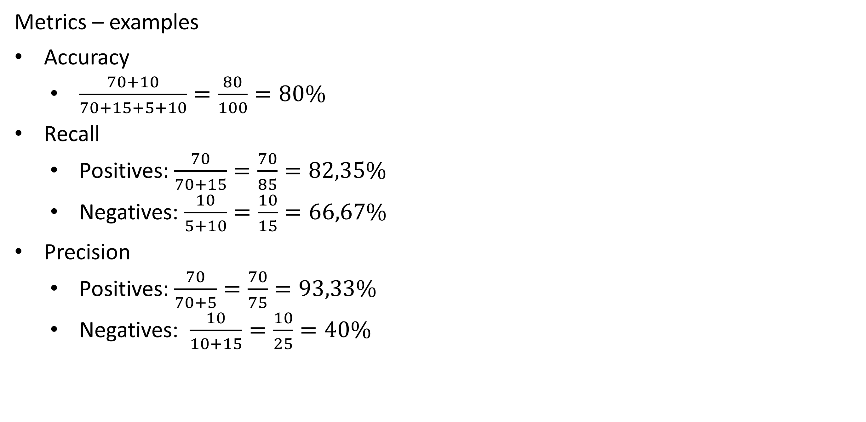
Evaluation of a classifier
Metrics – examples
Accuracy
$\frac{70+10}{70+15+5+10}=\frac{80}{100}=80\%$
Recall
Positives: $\frac{70}{70+15}=\frac{70}{85}=82,35\%$
Negatives: $\frac{10}{5+10}=\frac{10}{15}=66,67\%$
Precision
Positives: $\frac{70}{70+5}=\frac{70}{75}=93,33\%$
Negatives: $\frac{10}{10+15}=\frac{10}{25}=40\%$
 | P’ (Predicted) | n’ (Predicted)
P (Actual) | 70 | 15
N (Actual) | 5 | 10

Slide 41
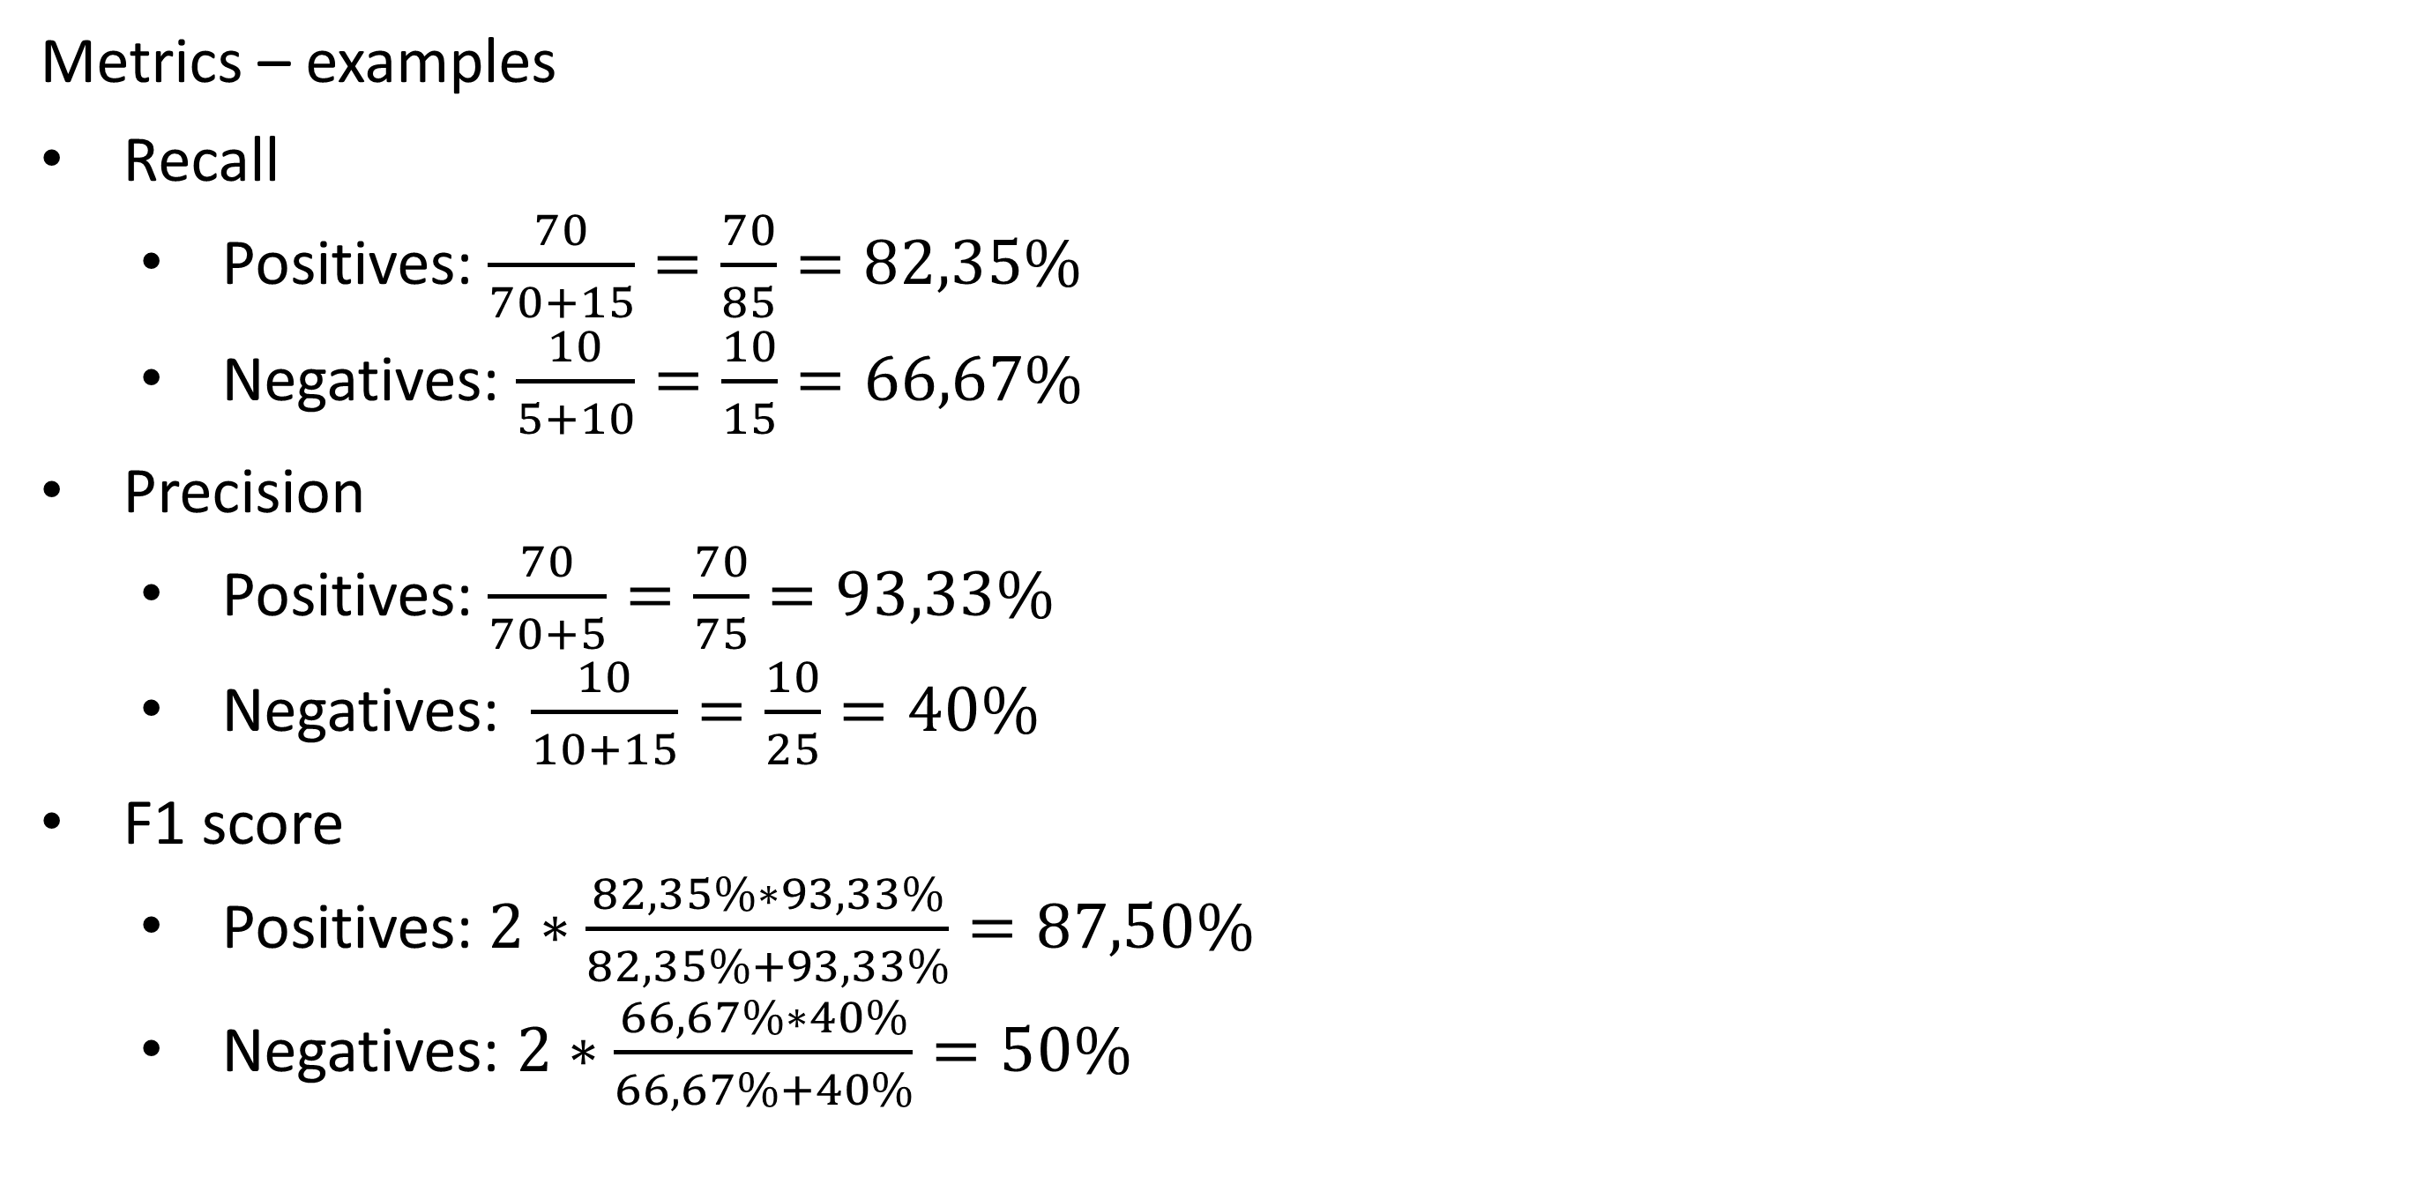
Evaluation of a classifier
Metrics – examples
Recall
Positives: $\frac{70}{70+15}=\frac{70}{85}=82,35\%$
Negatives: $\frac{10}{5+10}=\frac{10}{15}=66,67\%$
Precision
Positives: $\frac{70}{70+5}=\frac{70}{75}=93,33\%$
Negatives: $\frac{10}{10+15}=\frac{10}{25}=40\%$
F1 score
Positives: $2∗\frac{82,35\%∗93,33\%}{82,35\%+93,33\%}=87,50\%$
Negatives: $2∗\frac{66,67\%∗40\%}{66,67\%+40\%}=50\%$
 | P’ (Predicted) | n’ (Predicted)
P (Actual) | 70 | 15
N (Actual) | 5 | 10

Slide 42
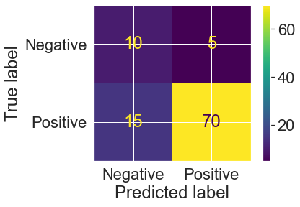
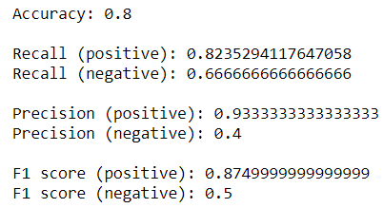
Evaluation of a classifier – sklearn
## confusion matrix is in form:
# [[TN, FP]
# [FN, TP]]
print(cf:=confusion_matrix(targets,y_pred)) # Note the use of the walrus operator.
# Extra: in case of 2 classes (binary classification), you can extract tp,tn,fp and fn:
tn, fp, fn, tp = cf.ravel()
print(f"True Positives: {tp}, False Positives: {fp}, True Negatives: {tn}, False Negatives: {fn}")
# Extra: create a "heatmap" plot of the confustion matrix
from sklearn.metrics import ConfusionMatrixDisplay
matrix = ConfusionMatrixDisplay(cf,display_labels=["Negative","Positive"]) # Without display_labels it will show class
# numbers (0|1)
matrix.plot()
plt.show()
# Accuracy
print(f"Accuracy: {accuracy_score(targets,y_pred)}\n")
# Recall
print(f"Recall (positive): {recall_score(targets,y_pred)}")
print(f"Recall (negative): {recall_score(targets,y_pred,pos_label=0)}\n")
# Precision
print(f"Precision (positive): {precision_score(targets,y_pred)}")
print(f"Precision (negative): {precision_score(targets,y_pred,pos_label=0)}\n")
# F1
print(f"F1 score (positive): {f1_score(targets,y_pred)}")
print(f"F1 score (negative): {f1_score(targets,y_pred,pos_label=0)}")

Slide 43
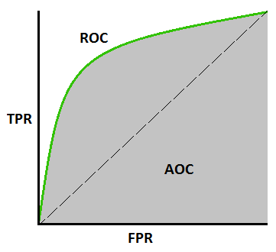
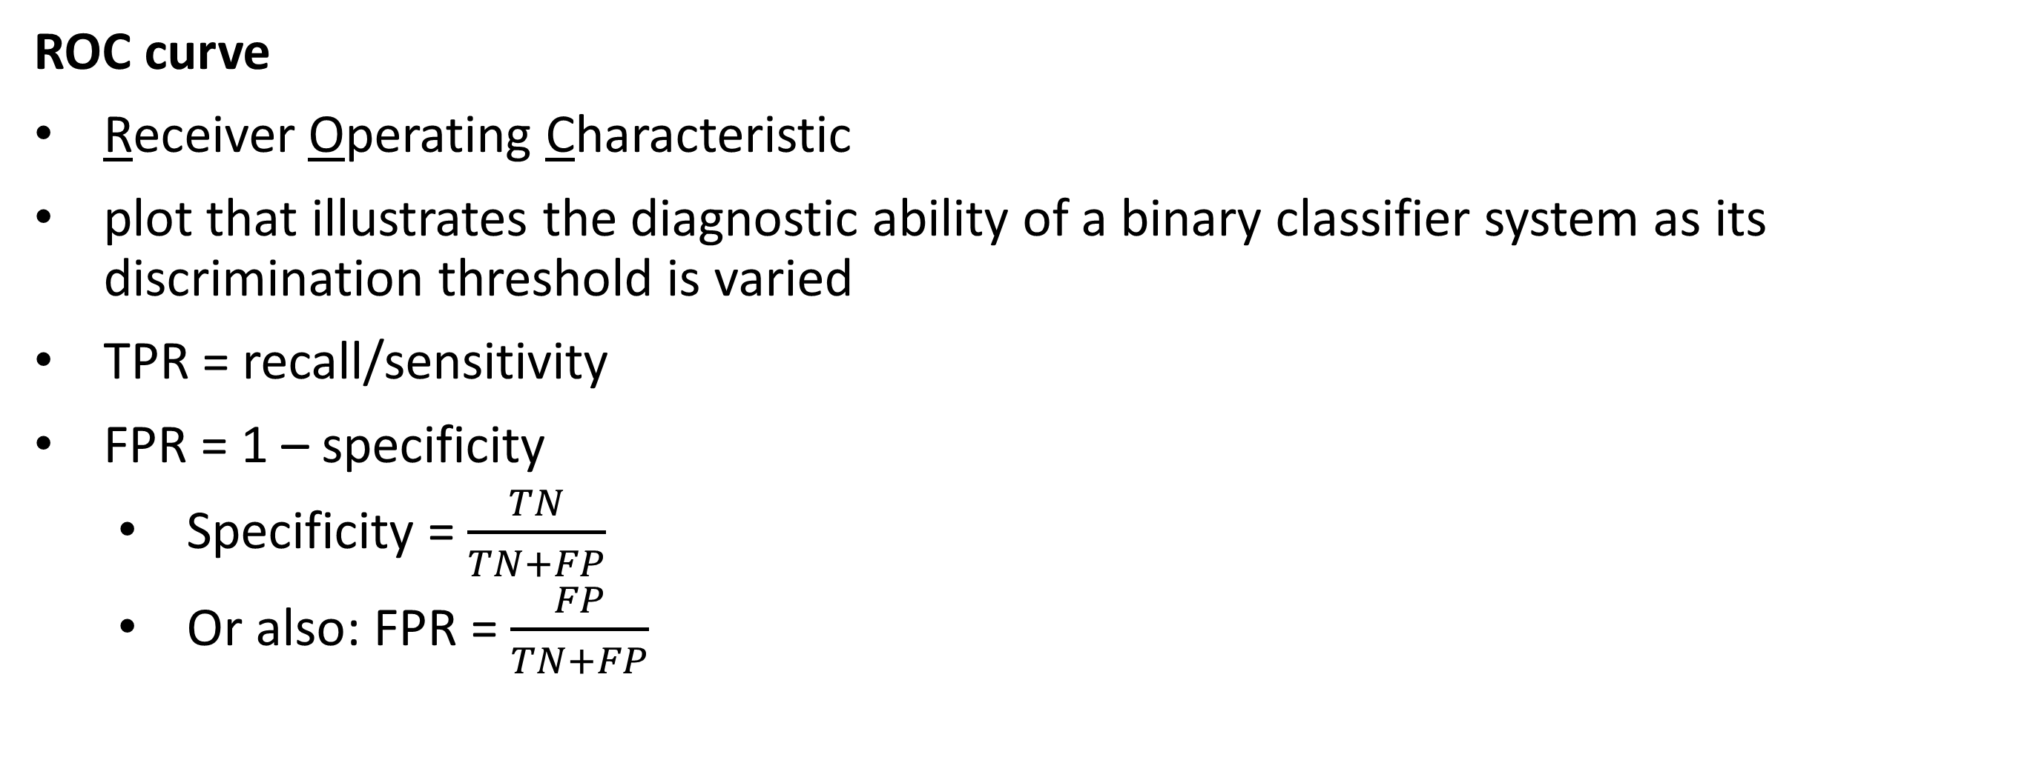
Evaluation of a classifier
ROC curve
Receiver Operating Characteristic
plot that illustrates the diagnostic ability of a binary classifier system as its discrimination threshold is varied
TPR = recall/sensitivity
FPR = 1 – specificity
Specificity = $\frac{TN}{TN+FP}$
Or also: FPR = $\frac{FP}{TN+FP}$

Slide 44
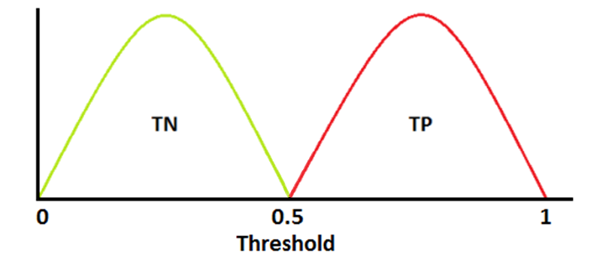
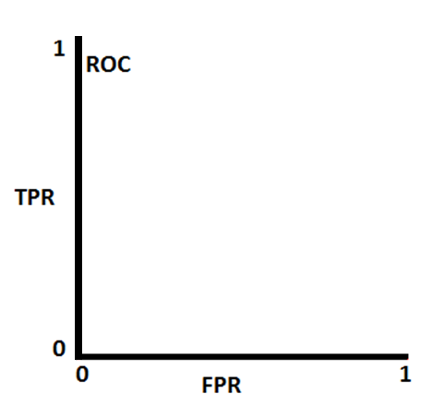
Evaluation of a classifier
ROC curve
ROC Heaven
TPR: 0/(0+8) = 0
FPR: 0/(6) = 0
TPR: 8/(8+0) = 1
FPR: 6/(0+6) = 1
TPR: 8/(8+0) = 1
FPR: 3/(3+3) = 0,5
TPR: 3/(3+5) = 0,325
FPR: 0/(6) = 0
TPR: 8/(8+0) = 1
FPR: 0/(6) = 0

Slide 45
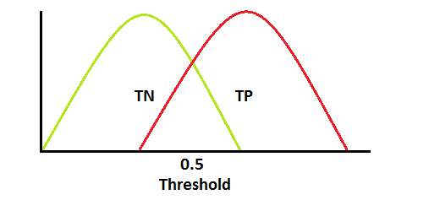
Evaluation of a classifier
ROC curve
TPR: 3/(3+5) = 0,325
FPR: 0/(6+0) = 0
TPR: 0/(0+8) = 0
FPR: 0/(6+0) = 0
TPR: 8/(8+0) = 1
FPR: 6/(0+6) = 1
TPR: 6/(6+2) = 0,75
FPR: 2/(4+2) = 0,33
TPR: 8/(8+0) = 1
FPR: 3/(3+3) = 0,5

Slide 46
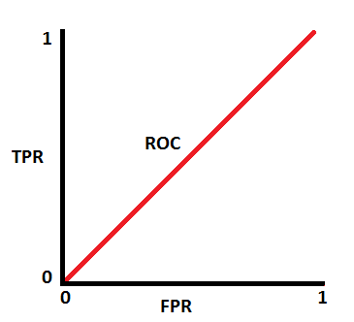
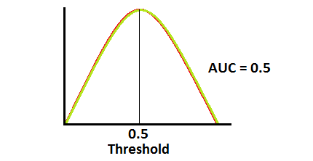
Evaluation of a classifier
ROC curve

Slide 47
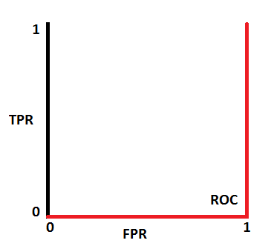
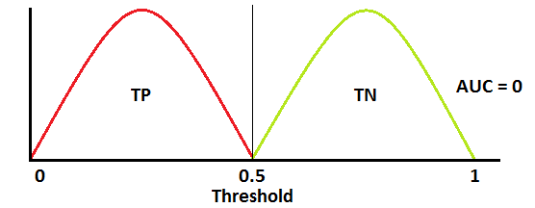
Evaluation of a classifier
ROC curve
ROC Hell

Slide 48
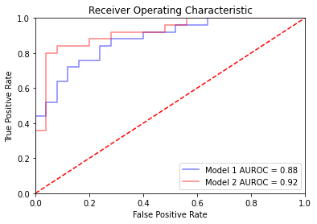
Evaluation of a classifier
AUROC/AOC
Area under the ROC curve
> AUROC
More true positives
Fewer false positives
Best model has higher AUROC
(Here: model 2)

